Slide 1
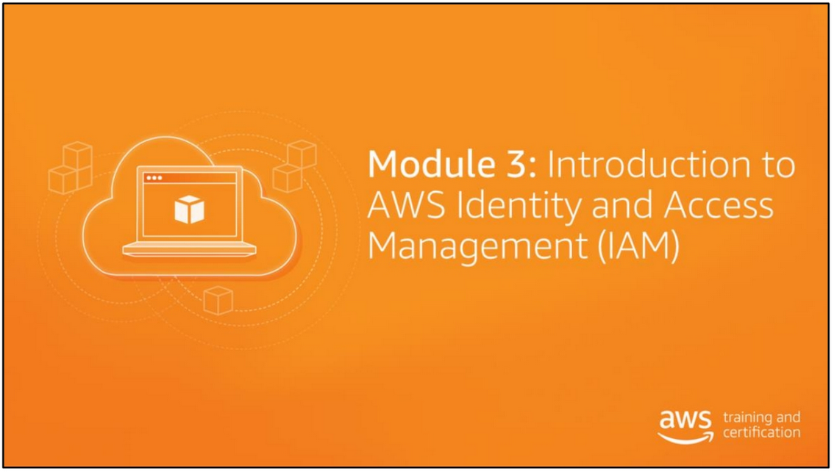

Slide 2
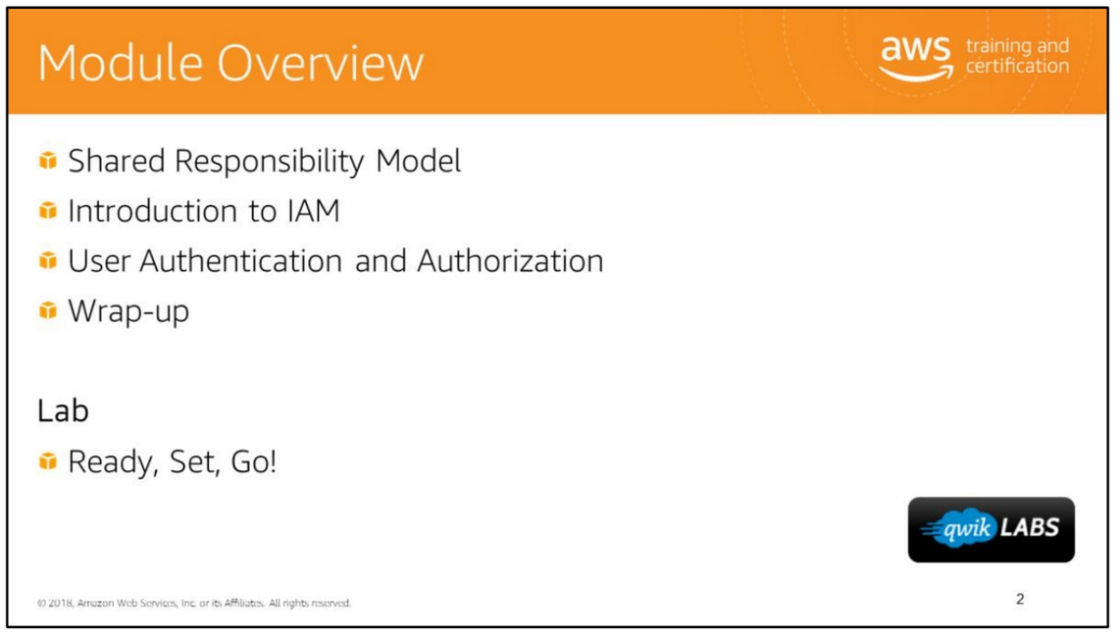

Slide 3
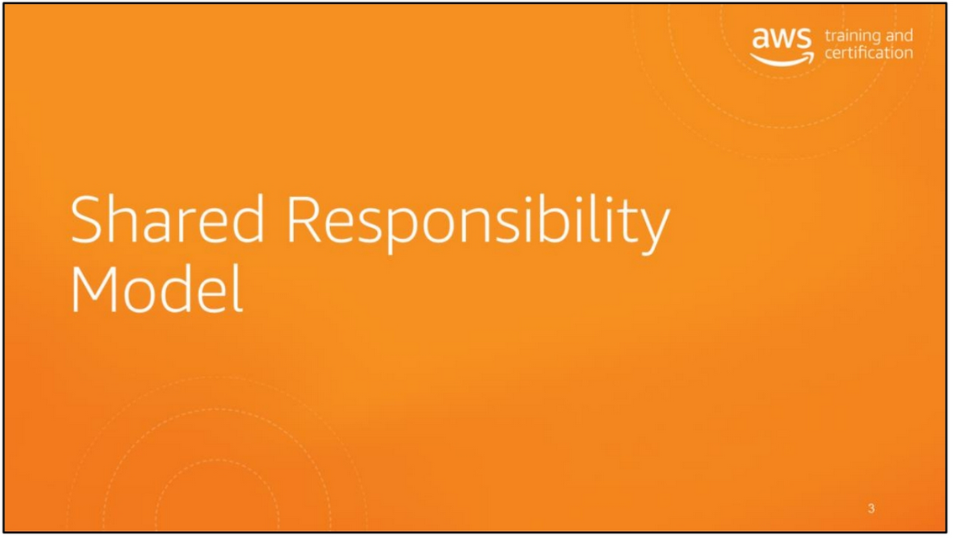

Slide 4
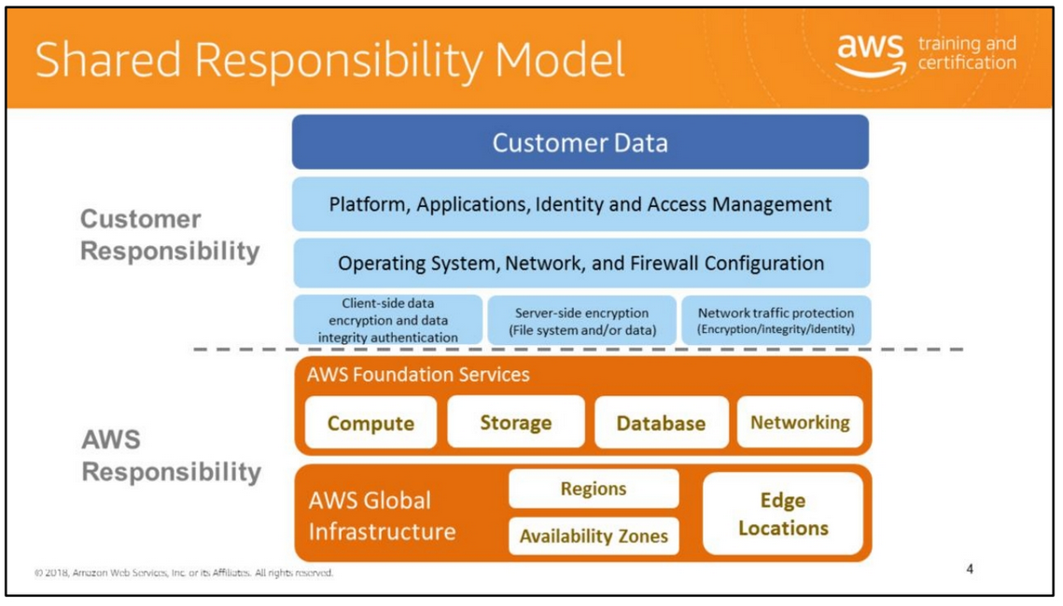
Amazon Web Services provides the same familiar approaches to security that companies have been using for decades. Importantly, it does this while also allowing the flexibility and low cost of cloud computing. There is no inherent conflict about providing on-demand infrastructure while also providing the security isolation that companies have become accustomed to in their existing, privately owned environments.
Security within the cloud is a joint effort between you (the customer) and the cloud provider (AWS). You are responsible for what you implement using AWS and for the applications you connect to AWS. The security steps you need to take depend on the services you use and the complexity of your system.
Our responsibility goes from the ground up to the hypervisor. We secure the hardware, software, facilities, and networks that run all of our products and services. Customers are responsible for securely configuring the services they sign up for and anything they put on those services.
AWS is responsible for:
• Obtaining industry certifications and independent third-party attestations.
• Publishing information about AWS security and control practices in whitepapers and web site content.
• Providing certificates, reports, and other documentation directly to AWS customers under NDA (as required).

Slide 5
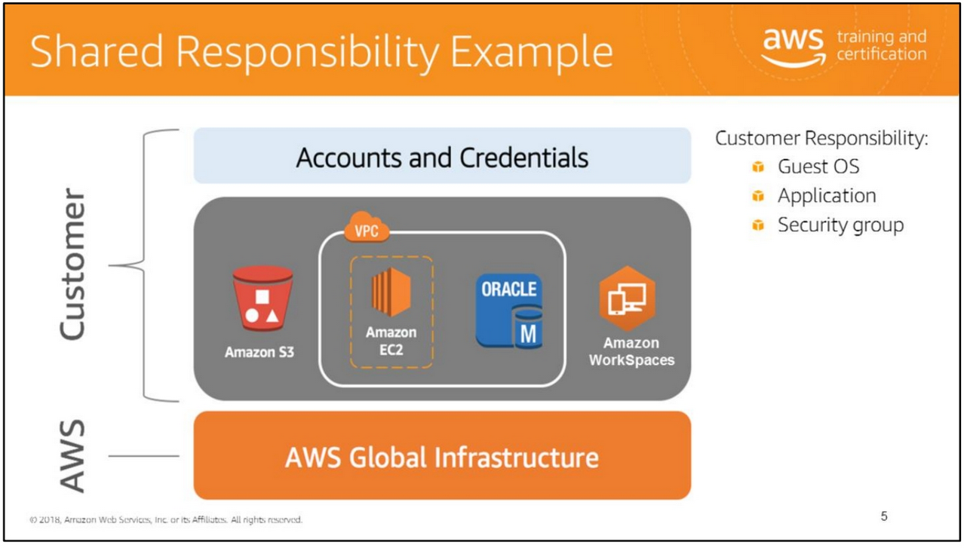
In order to visualize the AWS Shared Responsibility Model, let’s take a look at an example. Let’s say a customer used Amazon S3 for storage and Amazon WorkSpaces for desktop. They also have a virtual private cloud (VPC) which consists of their EC2 instance and Oracle DB instance.
AWS is responsible for protecting the global infrastructure that runs all of the services offered in the AWS cloud. The AWS global infrastructure is designed and managed according to security best practices and a variety of security compliance standards.
AWS products that fall into the category of Infrastructure as a Service (IaaS), such as Amazon EC2 and Amazon VPC, are completely under your control and require you to perform all of the necessary security configuration and management tasks. For example, for EC2 instances, you’re responsible for management of the guest OS (including updates and security patches), any application software or utilities you install on the instances, and the configuration of the AWS provided firewall (called a security group) on each instance. These are basically the same security tasks that you’re used to performing no matter where your servers are located.
It is best practice for customers to protect their AWS account credentials and set up individual user accounts with AWS Identity and Access Management (IAM) so that each user has their own credentials.

Slide 6
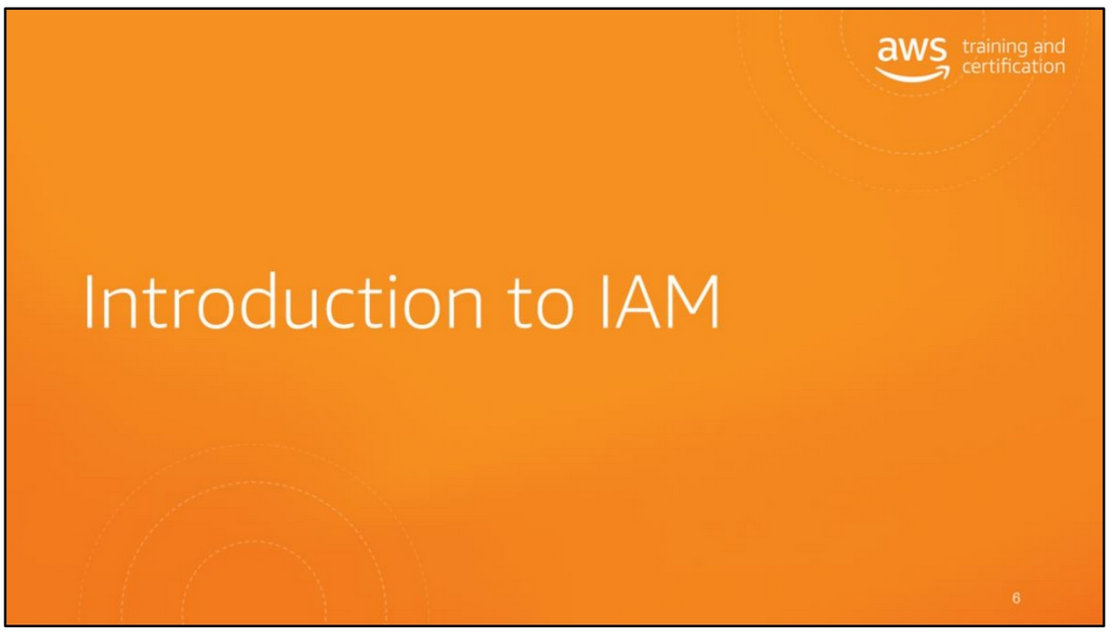

Slide 7
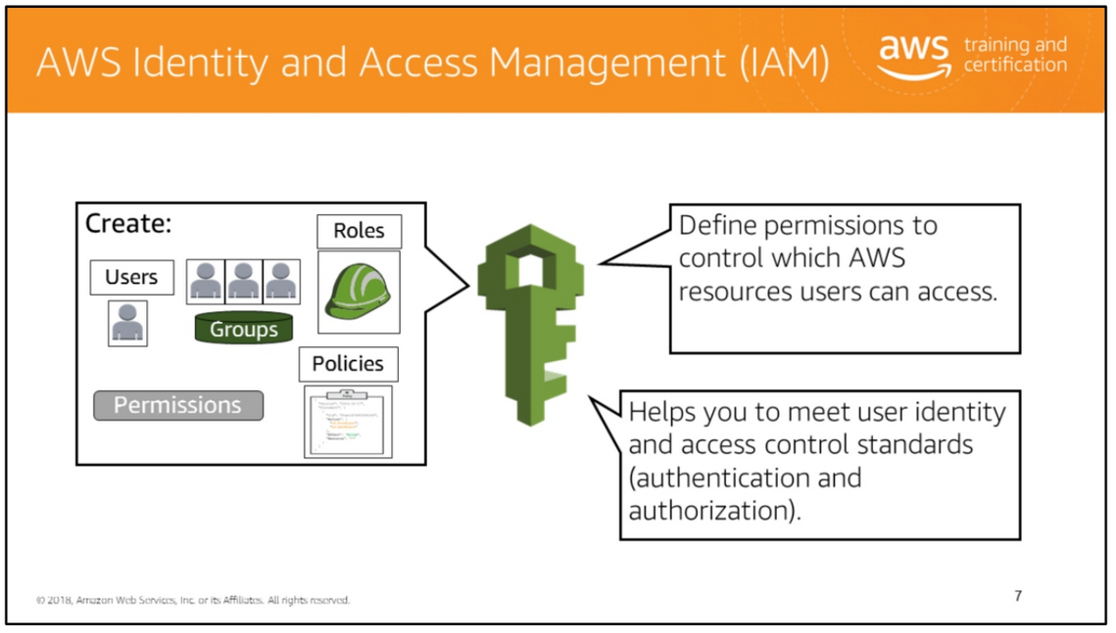
AWS Identity and Access Management (IAM) is a web service that helps you securely control access to AWS resources for your users. You use IAM to control who can use your AWS resources (authentication) and what resources they can use and in what ways (authorization).
Think of the access control concepts you’re already familiar with such as users (think of these as your end users), groups (think of these as a collection of users by job function), permissions (which can be applied to users or groups), and roles (think of these as trusted entities). That’s exactly what IAM uses which makes it so powerful!
The main features to AWS IAM are: management of users, management of roles, and management of federated users. Using AWS IAM, you can create and manage AWS users and groups and use permissions to allow and deny their access to AWS resources. You can use existing corporate identities to grant secure access to AWS resources without creating any new AWS identities.
An IAM role is similar to a user, in that it is an AWS identity with permission policies that determine what the identity can and cannot do in AWS. A role is intended to be
AWS Identity and Access Management (IAM) is a web service that helps you securely control access to AWS resources for your users. You use IAM to control who can use your AWS resources (authentication) and what resources they can use and in what ways (authorization).
Think of the access control concepts you’re already familiar with such as users (think of these as your end users), groups (think of these as a collection of users by job function), permissions (which can be applied to users or groups), and roles (think of these as trusted entities). That’s exactly what IAM uses which makes it so powerful!
The main features to AWS IAM are: management of users, management of roles, and management of federated users. Using AWS IAM, you can create and manage AWS users and groups and use permissions to allow and deny their access to AWS resources. You can use existing corporate identities to grant secure access to AWS resources without creating any new AWS identities.
An IAM role is similar to a user, in that it is an AWS identity with permission policies that determine what the identity can and cannot do in AWS. A role is intended to be
assumable by anyone or thing who needs it. A role does not have standard long-term credentials (password or access keys) associated with it. Instead, if a user assumes a role, temporary security credentials are created dynamically and provided to the user.
For more information, see
http://docs.aws.amazon.com/IAM/latest/UserGuide/reference_aws-services-that-work-with-iam.html.

Slide 8
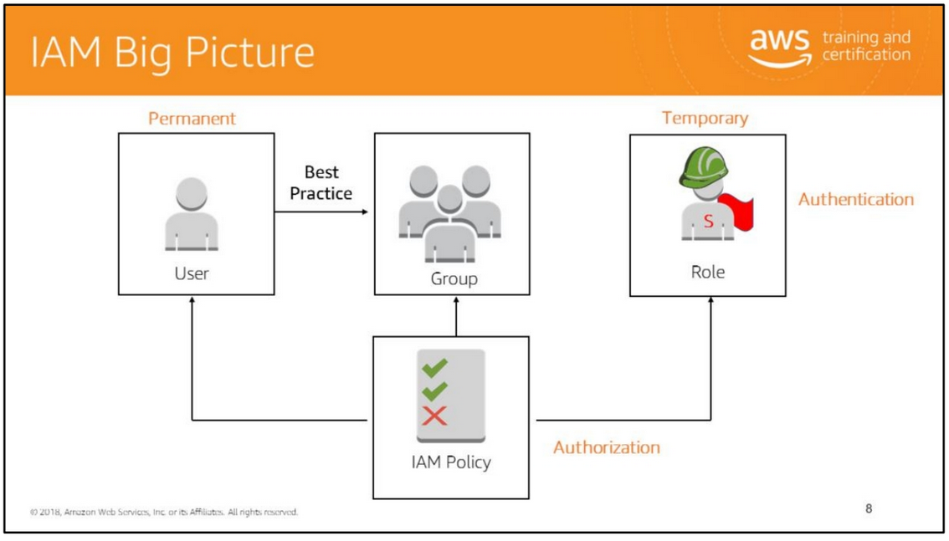

Slide 9
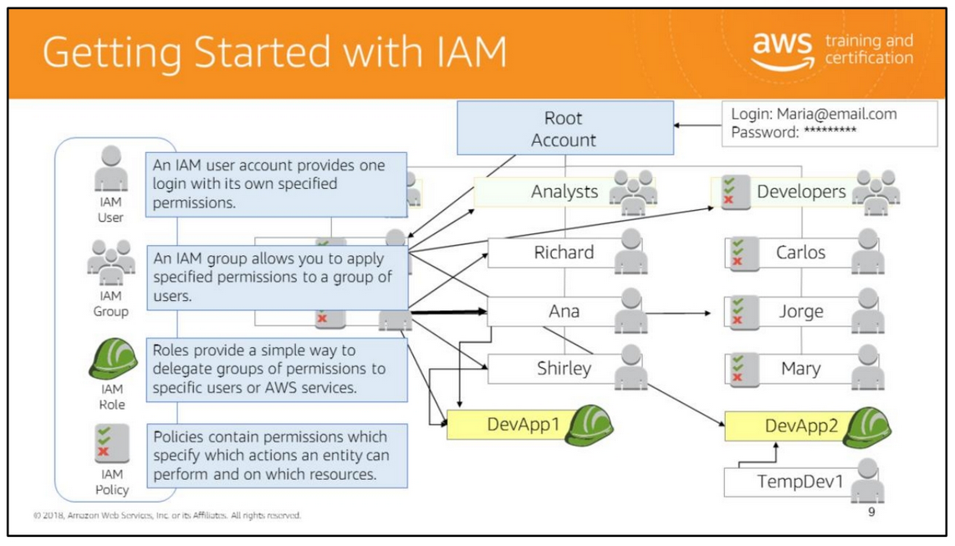
Example Maria starts her own company and decides to use AWS for its cloud-based infrastructure.
1. She opens an AWS account. This is her company's AWS account credentials, and as such should not be used for day-to-day administration.
2. Maria creates an IAM user for herself to use as her primary login.
3. She applies a set of basic permissions to her IAM user. To provide the most fine-grained level of access control, she gives this IAM user read-only access to all AWS services. AWS offers managed policies, which include read-only, full access, and other basic permission configurations. Users with appropriate IAM permissions (and AWS account credentials) use these policies, modify them, or even create their own.
4. With her AWS account credentials, she creates an IAM group only for administrators.
5. She applies a specific policy that grants this IAM group administrative access to AWS services.
6. She adds her IAM user account to this group, which grants that IAM user the permissions of the group for as long as that IAM user is kept in that group.

Slide 10
7. She hires another administrator, Joe, and gives him an IAM user account with read-only access. She wants to manage the group policies herself because she's worried that Joe is new and might make a mistake and grant too many permissions to the wrong users by accident. So, in his IAM's user policy, she explicitly denies him access to creating IAM groups and attaching policies to them. Technically, he doesn't yet have access to any administrative permissions. This will become relevant after the next step.
8. Maria adds Joe to the Administrators group. This grants Joe all of the same administrative permissions as Maria; however, because his IAM user policy includes an explicit denial of IAM group permissions, that part of his group policy is overridden, and he is denied those specified permissions.
9. Maria creates a new IAM group for her company's analysts. She sets the permissions granted by this group, which are less privileged than the administrators group, because analysts don't need those permissions to do their work.
10. Joe creates the IAM users for the analysts, grants them all their own user policies, and then places those users into the Analysts IAM group. Although he can't create IAM groups or manage their policies, he still has permissions (from his Administrator group policy) to add users to and remove them from IAM groups.
11. Maria and Joe repeat this process for their Developers IAM group.
12. Maria decides to add fine-grained access to her access controls. She creates IAM roles to grant specific permissions to specific users:
a. She creates the "EMR1" role, which grants extra permissions to analysts working on a single specific project. After the project is completed, she can remove that role.
b. She also creates the "DevApp1" role, which she uses to grant a more restrictive set of policies to some temporary staff who have been brought in to help work on a specific application. This way, temporary developers aren't granted the same broad level of access as that of the permanent staff in the Developers IAM group.
Note: User does not necessarily mean “a person”; it specifies the access the user can have. However, as a best practice, you want to associate each account with a specific user for accountability. For example, you want to be able to trace who launched 20 instances on October 16, 2015, through the logs.

Slide 11
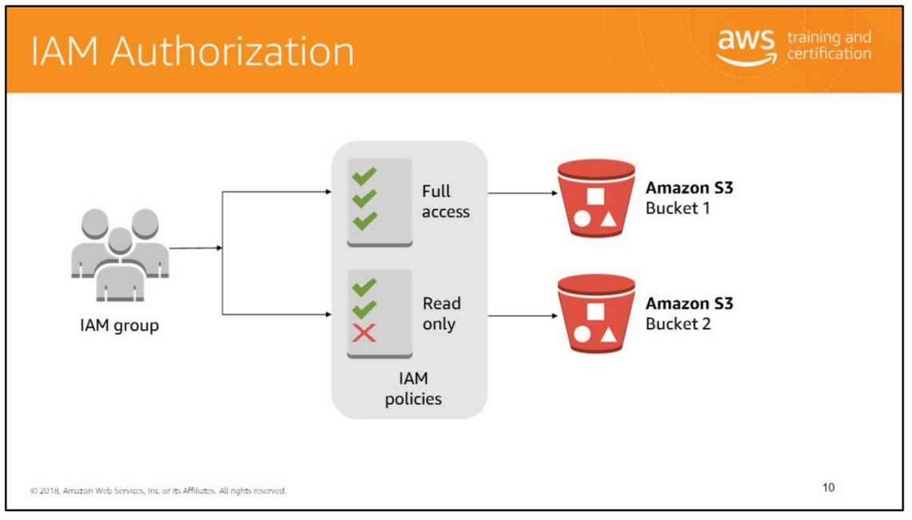
After a user has been authenticated, they have to be authorized to access AWS services. By default, IAM users can't access anything in your account. You need to grant permissions to a user by creating a policy, which is a document in JSON format that explicitly lists permissions.
IAM policies are specified with JSON-formatted text. More information about the policy language is provided later in this module. Policies are used to control access permissions for AWS APIs and other AWS resources. They are not used for operating system permissions or application permissions. For those, use LDAP or Active Directory/Active Directory Federation Services (AD FS).
When you create IAM policies, follow the standard security advice of granting least privilege; i.e., grant only the permissions required to perform a task. Determine what users need to do, and then craft policies for them that let the users perform only those tasks. Similarly, create policies for individual resources that identify precisely who is allowed to access the resource, and allow only the minimal permissions for those users. For example, perhaps developers should be allowed to create EC2
After a user has been authenticated, they have to be authorized to access AWS services. By default, IAM users can't access anything in your account. You need to grant permissions to a user by creating a policy, which is a document in JSON format that explicitly lists permissions.
IAM policies are specified with JSON-formatted text. More information about the policy language is provided later in this module. Policies are used to control access permissions for AWS APIs and other AWS resources. They are not used for operating system permissions or application permissions. For those, use LDAP or Active Directory/Active Directory Federation Services (AD FS).
When you create IAM policies, follow the standard security advice of granting least privilege; i.e., grant only the permissions required to perform a task. Determine what users need to do, and then craft policies for them that let the users perform only those tasks. Similarly, create policies for individual resources that identify precisely who is allowed to access the resource, and allow only the minimal permissions for those users. For example, perhaps developers should be allowed to create EC2

Slide 12
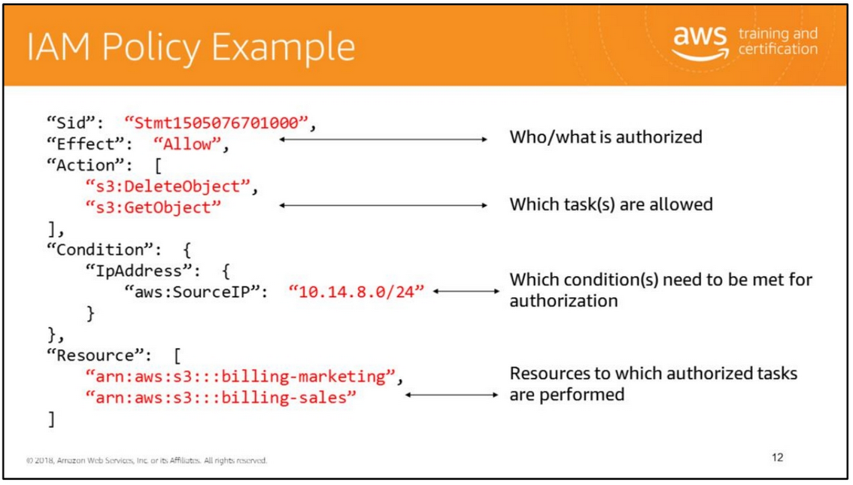
An IAM Policy is a JSON document that defines the effect, actions, resources, and optional conditions for what API calls an entity can invoke. Any actions or resources that are not explicitly allowed are denied by default. Let’s take a look at the sample policy we have on screen. The first line of the policy describes who or what is being authorized. This could be a user, a group, or another resource within AWS. The Action values describes which tasks are allowed to be performed. In this case, we have two API calls to Amazon S3. Next, we have the condition for this authorization to be successful. Only calls from the IP address listed here will have the designated permissions. Finally, the policy describes the resources to which the authorized tasks are to be performed.

Slide 13
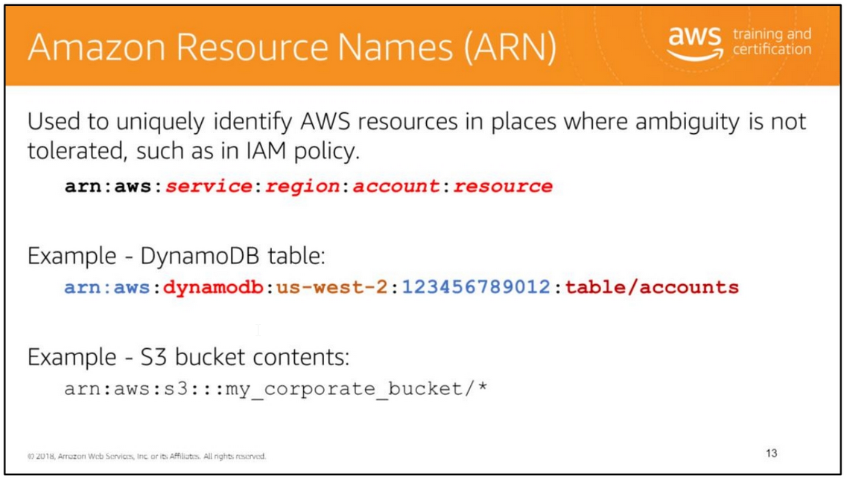
Amazon Resource Names (ARNs) allow you to uniquely identify AWS resources or groups of resources. The first example provides a full ARN. The second has a few fields missing. In many cases, a partial ARN is sufficient. In the Amazon S3 example, the partial ARN is still able to provide an unambiguous reference because bucket names are globally unique; therefore, the region and account portions are unnecessary.
Only one wildcard can be used in an ARN.
Structure of an ARN 1. All ARNs start the same way, with arn:aws.

Slide 14
2. The identifier for the product or service. For a list of allowed namespaces, see http://docs.aws.amazon.com/general/latest/gr/aws-arns-and-namespaces.html.
3. The region that the resources reside in. If the resource is globally unique, the region can be omitted. For example, the physical storage for S3 buckets is in the region that the bucket was created, but the name of the bucket is globally unique, so the bucket can be accessed without knowing the region that physically hosts the data. Because of this, the region can be omitted from an ARN that describes an S3 resource. DynamoDB tables, however, only need to be unique for the account and region they are located in. In other words, you can create a table with the same name in each region, and someone with another account is free to create their own tables with names identical to yours. There won’t be a naming conflict because ARNs for DynamoDB must contain the region and account number.
4. The account number portion of the ARN. When your account number is listed (in the AWS Management Console, for example), it usually contains hyphens. The hyphens are omitted from the ARN.

Slide 15
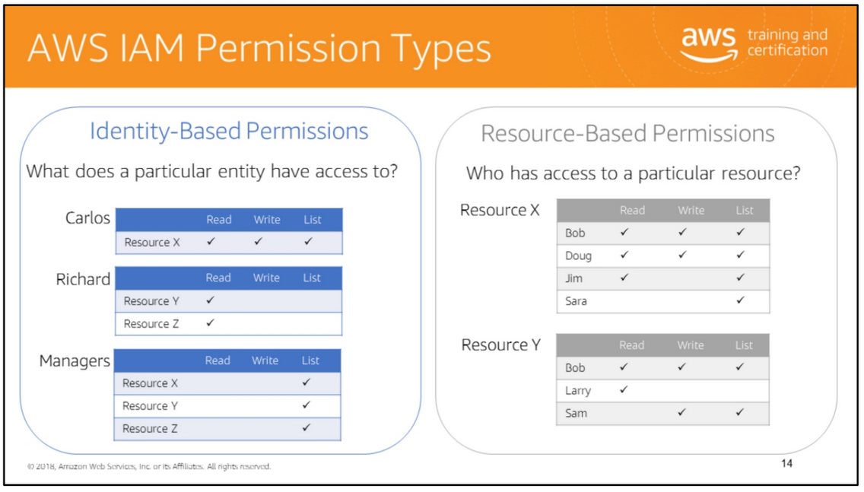
IAM permissions define the actions that an entity is allowed (or not allowed) to perform, for which resources, and under what conditions.
There are two types of permissions: identity-based and resource-based. They are nearly identical in appearance and function but have some slight syntax differences. The difference between the two types of permissions is in where they are applied.
Identity-based permissions are attached to the IAM user and indicate what the user is permitted to do.
Resource-based permissions are attached to a resource and indicate what a specified user (or group of users) is permitted to do with it. Amazon S3, Amazon Simple Queue Service (Amazon SQS), Amazon Simple Notification Service (Amazon SNS), and AWS OpsWorks are the only services that support resource-based permissions.
For information about the types of permissions supported by each service and the granularity at which service resources are defined, see http://docs.aws.amazon.com/IAM/latest/UserGuide/Using_SpecificProducts.html .

Slide 16
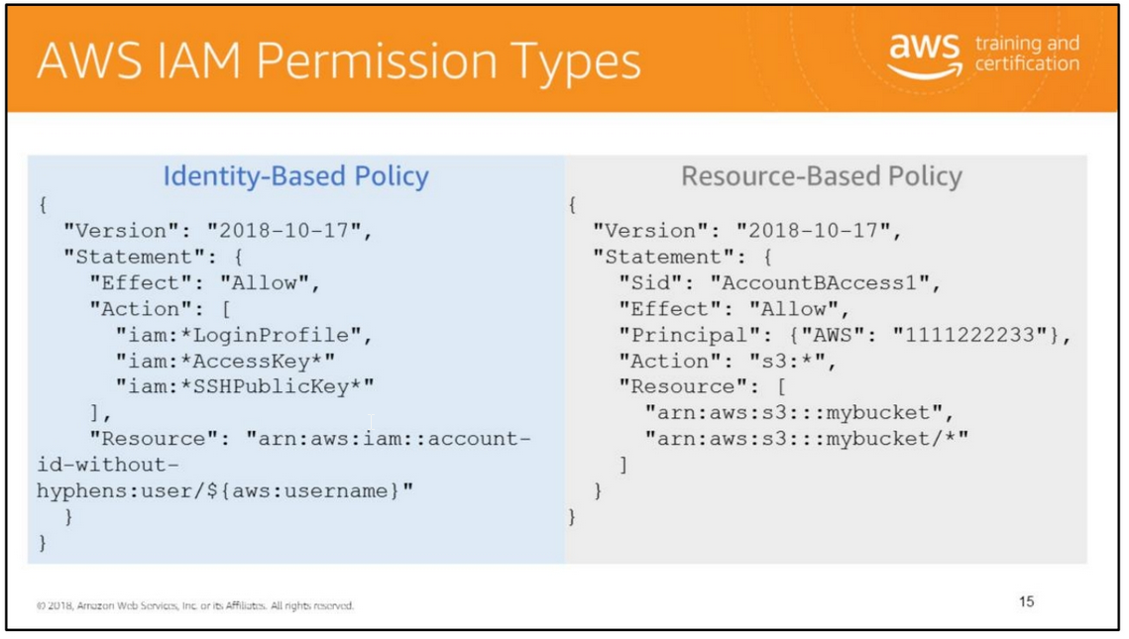
The slide illustrates examples of an identity-based policy and a resource-based policy.
Identity-Based Policies The identity-based policy allows users to manage their credentials with the AWS CLI, Tools for Windows PowerShell, the AWS SDKs, or the IAM HTTP-query API. It allows users to do the following:
• Create, change, or remove their own password by using the LoginProfile actions.
• Create or delete their own access key (access key ID and secret access key) by using the AccessKey actions.
• Create or delete their own SSH keys by using the SSHPublicKey actions.
The actions in the policy include wildcards (for example, iam:*LoginProfile, iam:*AccessKey*, and iam:*SSHPublicKey*). This is a convenient way to include a set of related actions.

Slide 17
Resource-Based Policies
In the resource-based policy example, account A uses a resource-based policy (an Amazon S3 bucket policy) to grant account B full access to account A's S3 bucket. Then account B creates an IAM user policy to delegate that access to account A's bucket to one of the users in account B.
The S3 bucket policy in account A might look like the policy on the slide. In this example, account A's S3 bucket is named mybucket, and account B's account number is 111122223333. It does not specify any individual users or groups in account B, only the account itself.

Slide 18
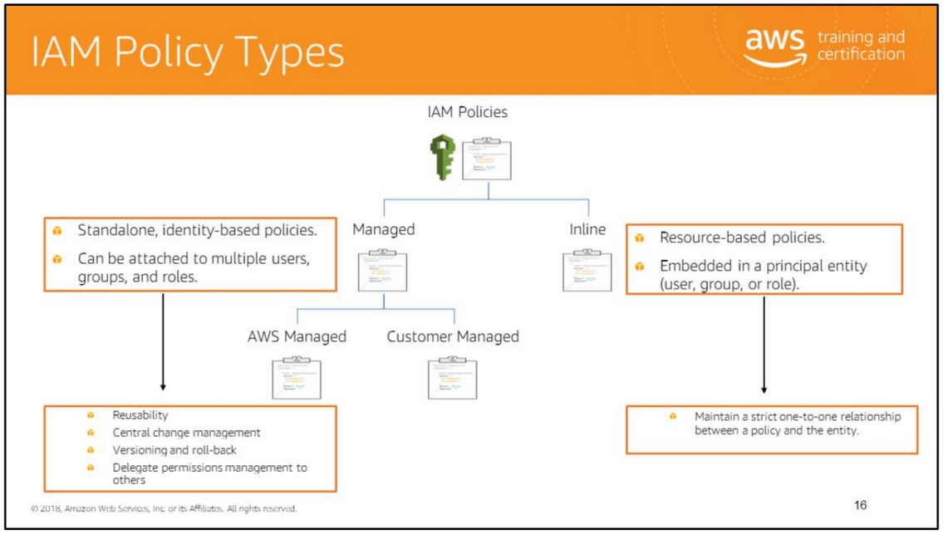
You can create two types of IAM policies: managed policies and inline policies. Managed policies are standalone policies that you can attach to multiple users, groups, and roles. You can use two types of managed policies:
• AWS managed policies: Managed policies that are created by AWS.
• Customer managed policies: Managed policies that are created and managed by you.
Managed policies provide several features, including reusability, central change management, versioning and roll back, and the ability to delegate permissions management to other users.
Inline policies are embedded in a principal entity like a user, group, or role: that is, the policy is an inherent part of the entity. You can use the same policy for multiple entities, but those entities are not sharing the policy; instead each has its own copy of the policy. This makes it impossible to centrally manage inline policies.
Inline policies are useful if you want to maintain a strict one-to-one relationship between a policy and the principal entity to which it is applied.

Slide 19
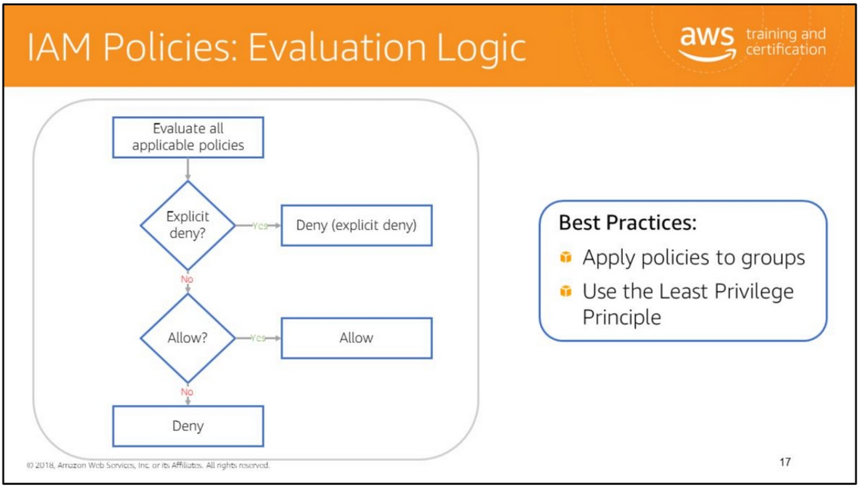
Policies allow you to fine-tune permissions granted to IAM users, groups, and roles. Policies can be in a variety of formats. Because policies are in JSON format, they can be used with a version control system. It’s good practice to define least privilege access to each user, group, or role. Then you can customize access to specific resources by using an authorization policy.
To determine whether the request should be allowed or denied, these rules are followed:
• By default, all requests are denied. (In general, requests made using the account/root credentials for resources in the account are always allowed.)
• An explicit allow overrides this default.
• An explicit deny overrides any allows.
This diagram shows the logic of evaluating IAM policies. All policies that have been applied to the IAM entity are evaluated. If there is a conflict (one policy allows an action and another policy denies an action ), the most restrictive policy (policy that denies the action ) is applied. The order in which the policies are evaluated has no effect on the outcome of the evaluation. All policies are evaluated, and the result is always that the request is either allowed or denied.

Slide 20
Next, if there is an explicit deny statement, the final decision is to deny the action. Next, if there is an allow statement, the final decision is to allow the action. However, if there isn’t an allow statement, then the final decision is to deny it.
Any actions that you didn’t explicitly allow are denied. Any actions that you explicitly deny are always denied. We recommend that you follow the least privilege principle when creating policies. Also, for users requiring the same policy, we recommend that you place the users into a group and then attach the policy to the group.
For more information on the IAM policy evaluation logic, see http://docs.aws.amazon.com/IAM/latest/UserGuide/AccessPolicyLanguage_Evaluatio nLogic.html.

Slide 21
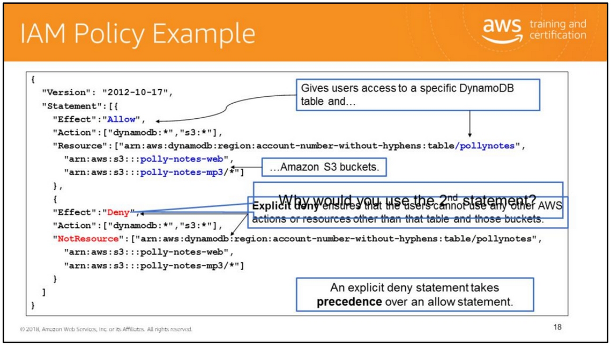
The policy gives users access to only the following:
• The DynamoDB table whose name is represented by table-name.
• The AWS account's corporate Amazon S3 bucket whose name is represented by bucket-name and all the objects it contains.
The policy includes an explicit deny ("Effect":"Deny" element). In conjunction with the NotResource element, this helps to ensure that the users can't use any AWS actions or resources except those specified in the policy, even if permissions have been granted in another policy. (An explicit deny statement takes precedence over an allow statement.)

Slide 22
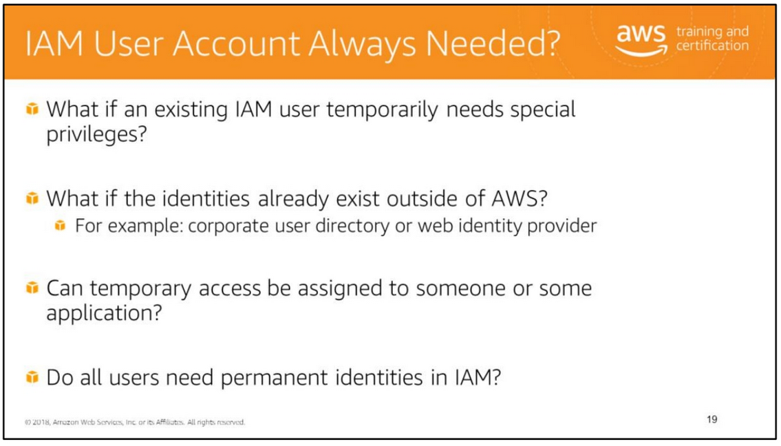
Sometimes you need to temporarily delegate access to users or services that normally don’t have access to your AWS resources. For example, a user in one AWS account might need access to resources in another account. Or a mobile app might user AWS resources, but you don’t want to store AWS keys with the app where they can be difficult to rotate and where users can potentially extract them.

Slide 23
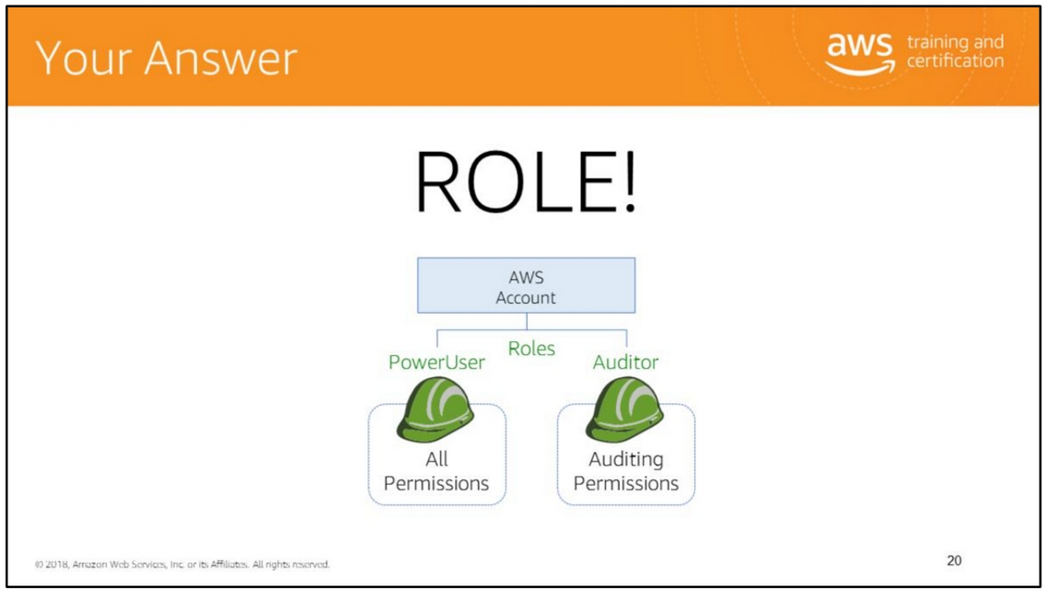

Slide 24
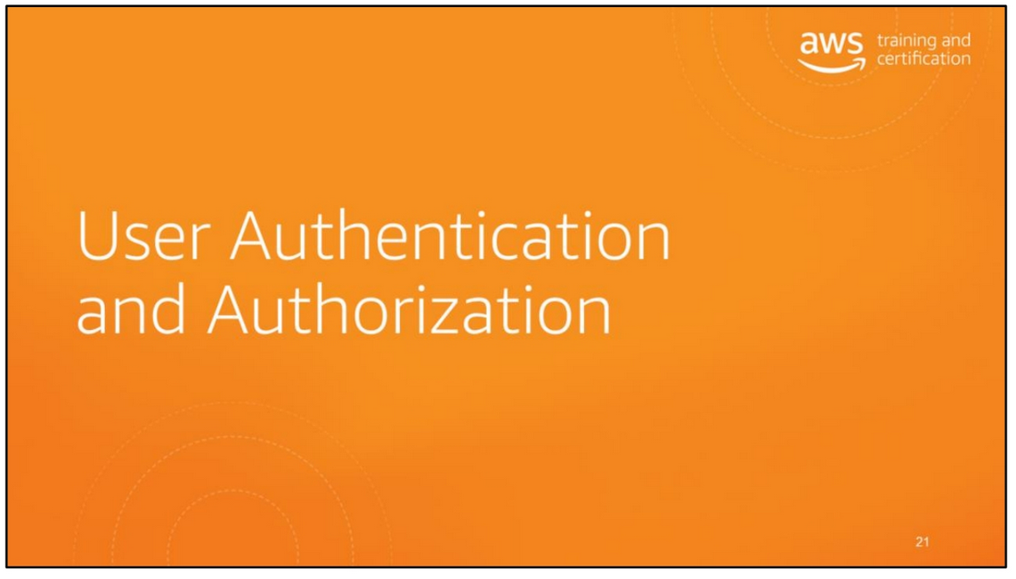

Slide 25
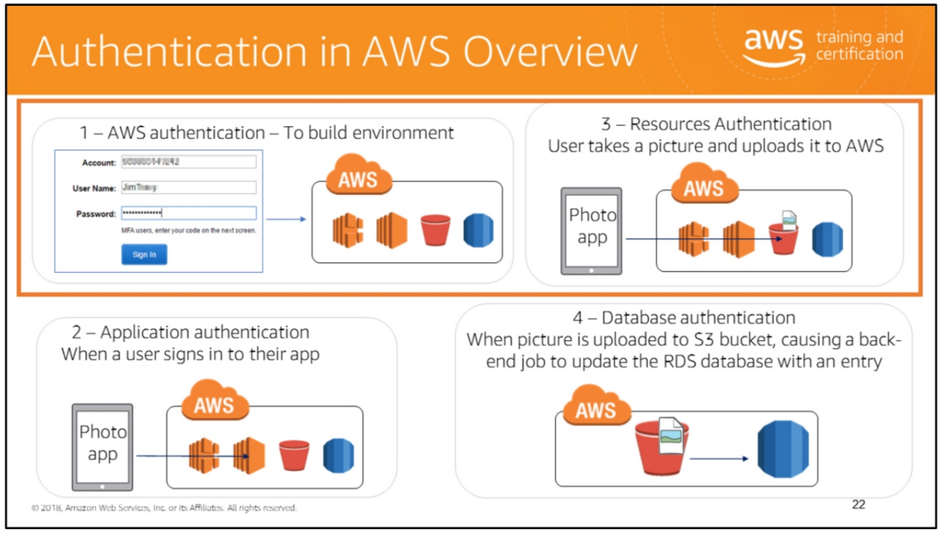
In the process of creating an AWS environment, there can be various types of authentication. For example, if you are developing a mobile photo application on AWS, you need to sign in to AWS using credentials to create the AWS environment for the photo application. Signing in to AWS here requires that you authenticate with AWS (AWS authentication). After the environment has been set up, the end user should be able to sign into their photo application. Signing into the photo application requires the user to authenticate with their application (application authentication). If the user takes a picture using their photo app and uploads it to AWS, authentication occurs with AWS (AWS Authentication). Finally, the photos that have been uploaded to the S3 bucket can cause a back-end job to update the RDS database with an entry for the uploaded photo. This job requires database authentication.

Slide 26
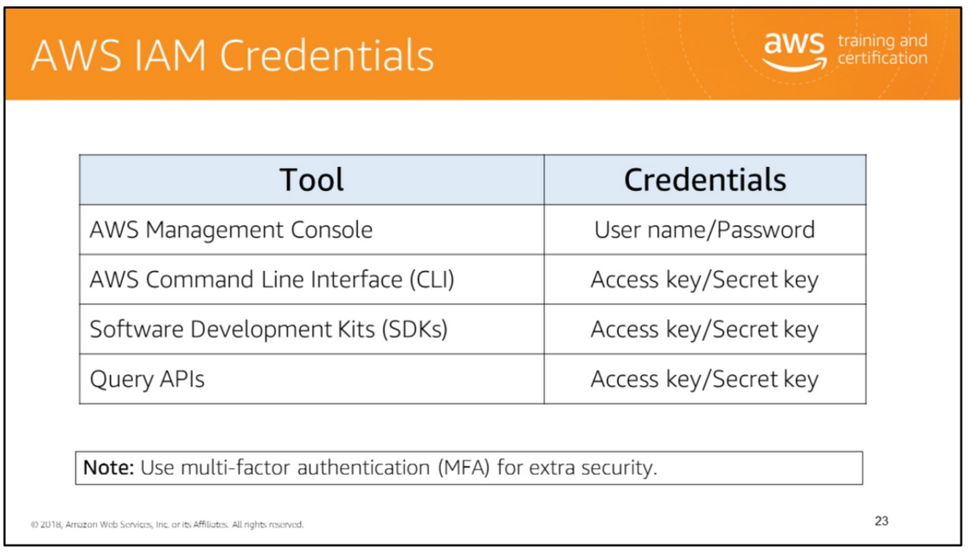
IAM credentials can come in a few different forms. The form you use depends on how you’re interacting with AWS.
Access keys (access key and secret key) are used to authenticate API requests, so are used primarily by system operators and developers. They can be generated for IAM users but are not created by default.
SSL sessions are used to authenticate API requests, much the same as the access keys do, but are intended for temporary use and must be paired with a session token. They are generated by the security token service and expire automatically based on the expiration that is set when they are created. They are generally used by an application to provide temporary permission to a software agent that some specific task is being delegated to.
IAM user credentials are used to provide sign-in access to the AWS Management Console. They consist of a user name and password. To use them, you need the AWS account number that was used to generate them or a special AWS console link that has the AWS account number encoded in it.

Slide 27
IAM credentials can come in a few different forms. The form you use depends on how you’re interacting with AWS.
Access keys (access key and secret key) are used to authenticate API requests, so are used primarily by system operators and developers. They can be generated for IAM users but are not created by default.
SSL sessions are used to authenticate API requests, much the same as the access keys do, but are intended for temporary use and must be paired with a session token. They are generated by the security token service and expire automatically based on the expiration that is set when they are created. They are generally used by an application to provide temporary permission to a software agent that some specific task is being delegated to.
IAM user credentials are used to provide sign-in access to the AWS Management Console. They consist of a user name and password. To use them, you need the AWS account number that was used to generate them or a special AWS console link that has the AWS account number encoded in it.
AWS user credentials are also referred to as root credentials.

Slide 28
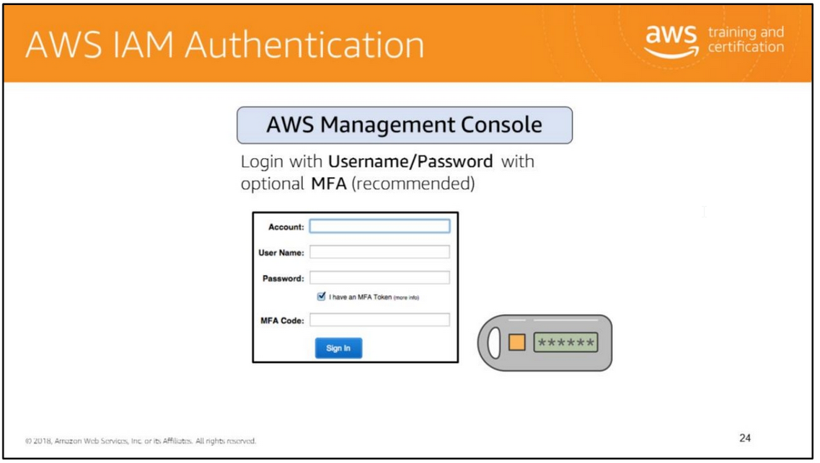
AWS services and resources can be accessed using the AWS Management Console, AWS CLI, or through SDKs and APIs from a wide range of supported platforms. Users and systems have to be authenticated before they can access AWS services and resources.
The AWS Management Console provides a web-based way to administer AWS services. If you're the account owner, you can sign in to the console directly using the Root Account. It is, however, advisable to create individual IAM users for each user and sign in using individual credentials.
IAM is a complimentary service. For more information, see http://docs.aws.amazon.com/IAM/latest/UserGuide/console.html.
The key takeaway here is that you use different approaches to login to the Console vs API access.
AWS services and resources can be accessed using the AWS Management Console, AWS CLI, or through SDKs and APIs from a wide range of supported platforms. Users and systems have to be authenticated before they can access AWS services and resources.
The AWS Management Console provides a web-based way to administer AWS services. If you're the account owner, you can sign in to the console directly using the Root Account. It is, however, advisable to create individual IAM users for each user and sign in using individual credentials.
IAM is a complimentary service. For more information, see http://docs.aws.amazon.com/IAM/latest/UserGuide/console.html.
The key takeaway here is that you use different approaches to login to the Console vs API access.

Slide 29
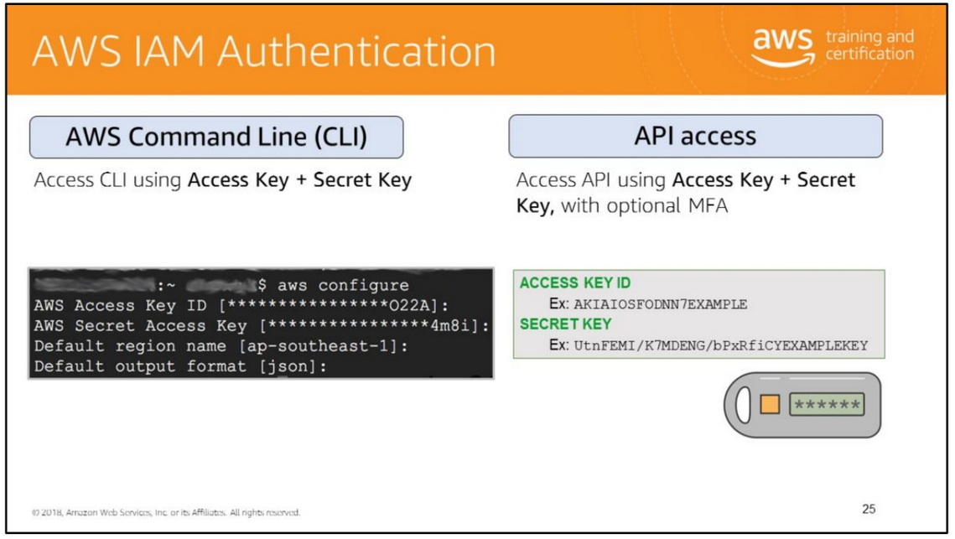
The AWS Command Line Interface is a unified tool to manage your AWS services. With AWS CLI, you can control multiple AWS services from the command line and automate them through scripts.
AWS CLI is supported on Windows, Linux, OS X, and Unix platforms.
AWS offers support for a wide variety of programming platforms, including .NET, Java, and Python.
For more information, see http://docs.aws.amazon.com/cli/latest/userguide/cli-chap-welcome.html.

Slide 30
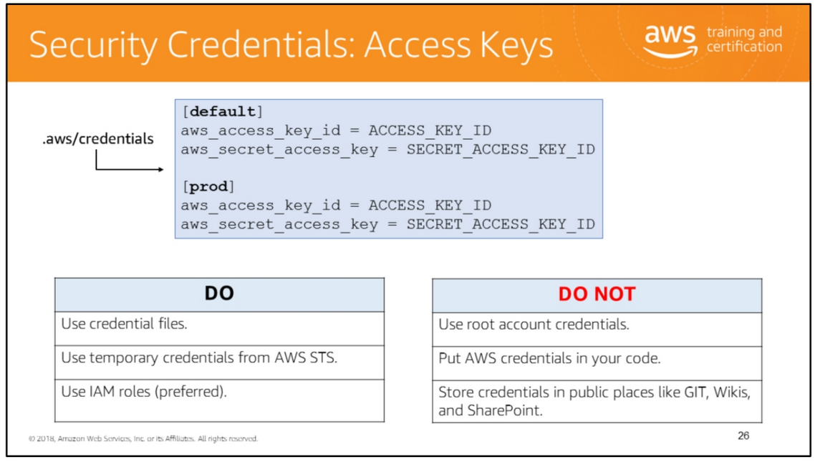
In order to authenticate requests, AWS services require you to provide your AWS access keys, also known as your AWS access key ID and secret access key. These access keys are often referred to collectively as your credentials.
You can use an AWS credentials file to specify your credentials. This is a special, INI-formatted file stored under your HOME directory, and is a good way to manage credentials for your development environment. The file should be placed at ~/.aws/credentials, where ~ represents your HOME directory. Using an AWS credentials file offers a few benefits:
• Your projects' credentials are stored outside of your projects, so there is no chance of accidentally committing them into version control.
• You can define and name multiple sets of credentials in one place.
• You can easily reuse the same credentials between projects.
• You can reuse your credentials with other supported AWS SDKs and tools.

Slide 31
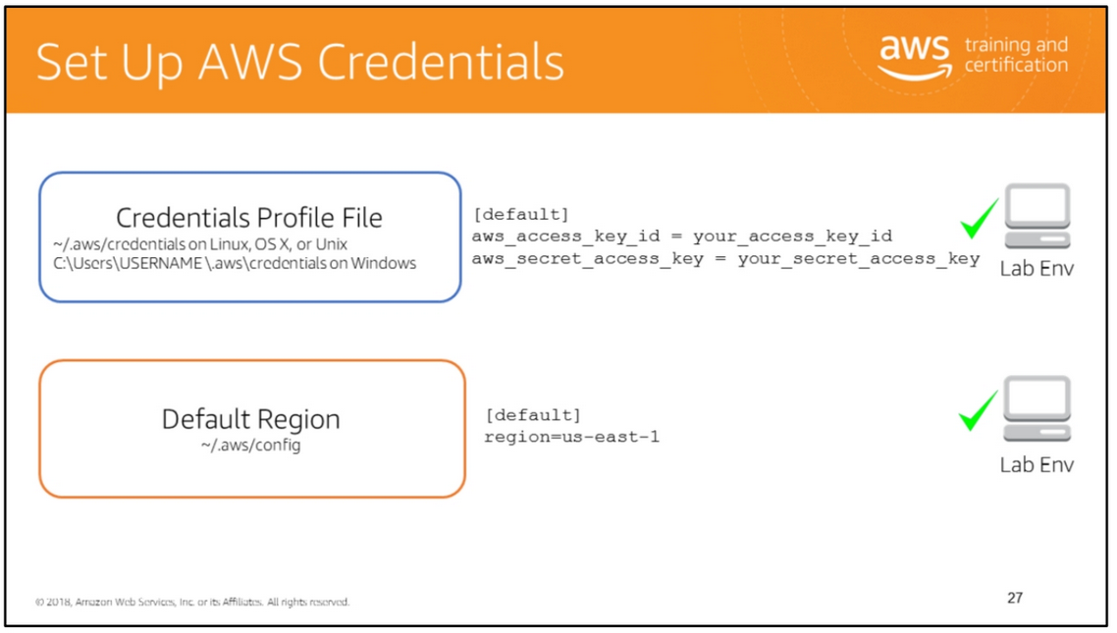
To set up your AWS credentials, you can create a credentials profile file at ~/.aws/credentials on Linux, OS X, or Unix or C:\Users\USERNAME \.aws\credentials on Windows. Add the aws_access_key_id and aws_secret_access_key that you received when you set up your account and downloaded your AWS credentials. The lab environment for this course uses this approach.
SDKs for different programming languages offer different ways of setting up your credentials. For more information, see AWS SDK documentation.
You can optionally set the default region in the ~/.aws/config file. The Boto 3 SDK for Python and AWS CLI use this setting to determine the default region.. The lab environment for this course sets the default region to the region that the lab’s EC2 instance is running on.

Slide 32
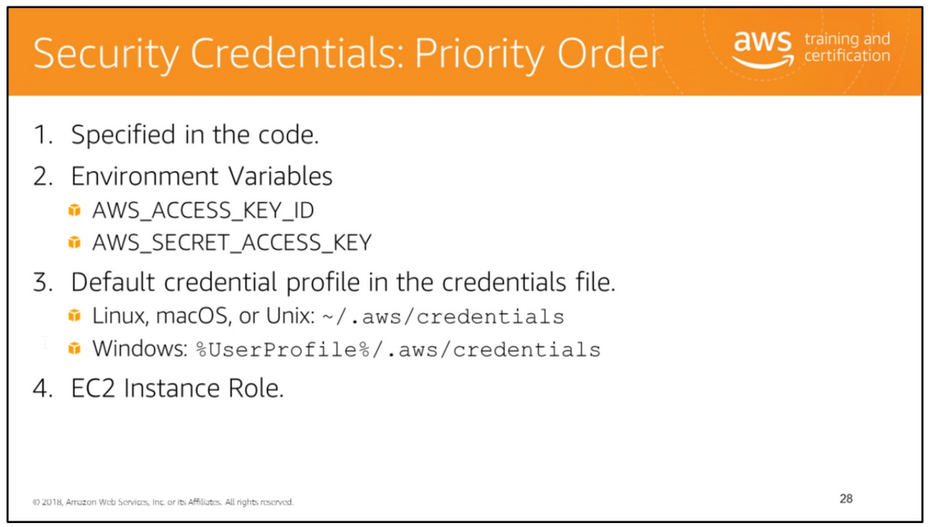

Slide 33
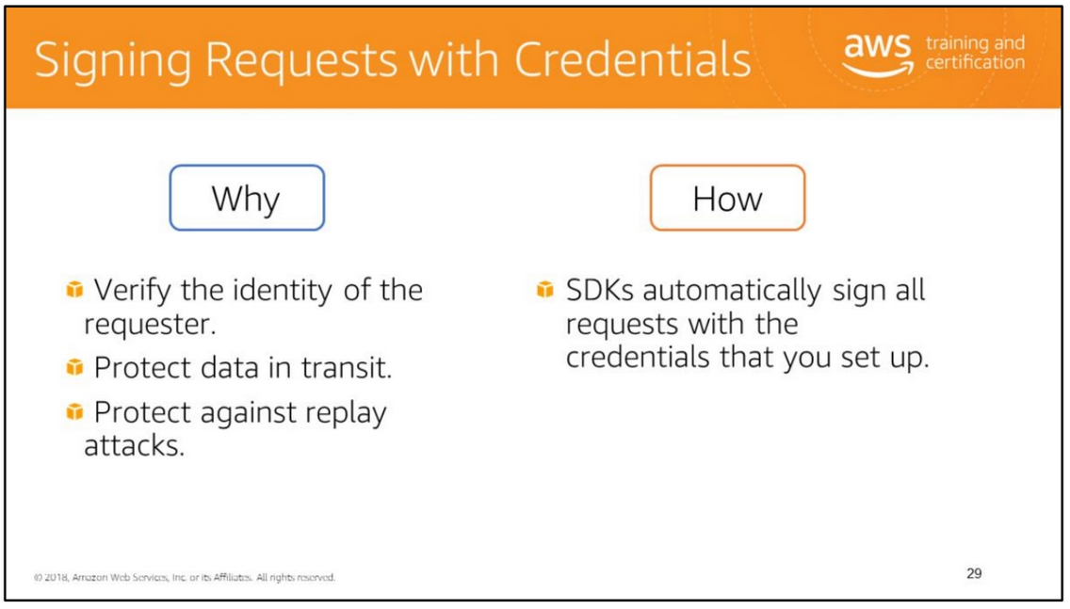
Requests to AWS services should be signed. In other words, requests must contain information required to authenticate the requester. Requests are signed by using the access key ID and secret access key of an account or of an IAM user.
Signing secures the request by:
• Verifying the identity of the requester: Signing ensures that the request has been issued by someone who has a valid access key ID and secret access key.
• Protecting data in transit: To prevent tampering with a request while it is in transit, some of the elements of the request are used to calculate a hash (digest) of the request. The resulting hash value is included in the request. When AWS receives the request, it recalculates the hash based on the same information and matches it against the hash value that was included in the request. AWS denies the request if the two hash values do not match.
• Protecting against replay attacks: To protect against replay attacks, all requests have a request expiration period (n minutes after the timestamp on the request). The exact duration of the request expiration period varies by service. If a request does not reach AWS within the expiration period, AWS denies the request.

Slide 34
For additional security, you should transmit your requests using Secure Sockets Layer (SSL) by using HTTPS. SSL encrypts the transmission thus protecting your request or the response from being viewed in transit.
You do not need to explicitly sign the requests when using one of the AWS SDKs, AWS CLI, or a service-specific CLI.
For more information, see http://docs.aws.amazon.com/general/latest/gr/signing_aws_api_requests.html.

Slide 35
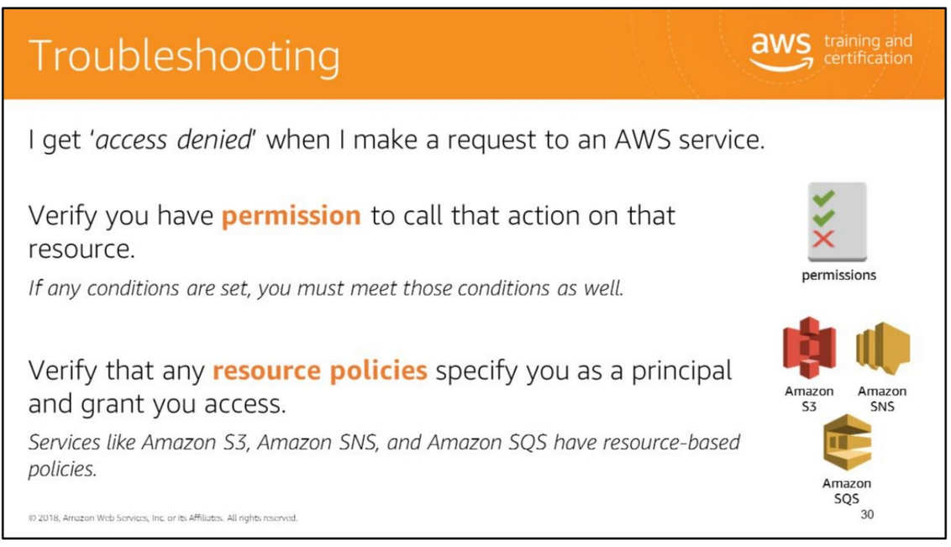

Slide 36


Slide 37
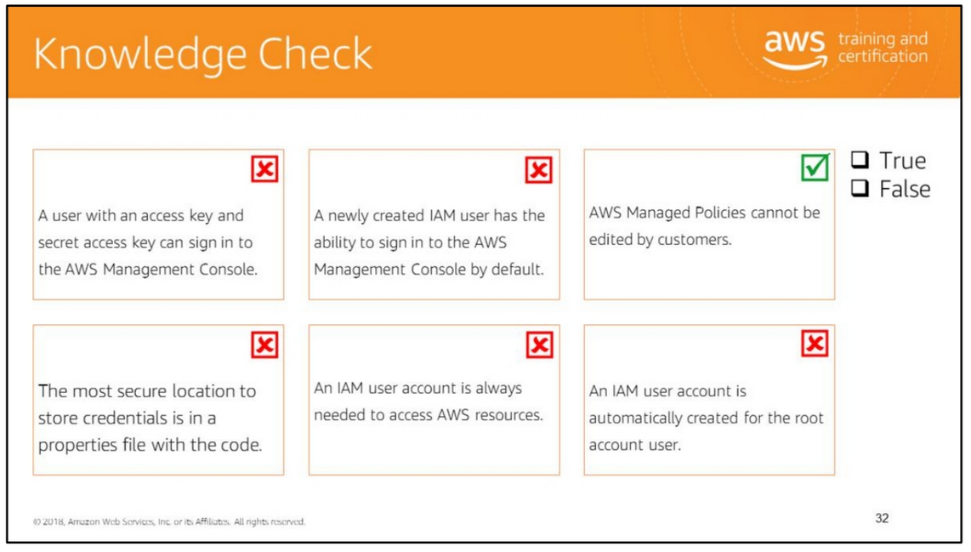
Read left to right:
(False) IAM users must be given a user name and password to sign in to the AWS Management Console.
(False) IAM users do not have any privileges by default. The IAM user must be given a user name and password to sign in to the AWS Management Console.
(True) An AWS managed policy is a standalone policy that is created and administered by AWS. You cannot change the permissions defined in AWS managed policies. AWS occasionally updates the permissions defined in an AWS managed policy. When AWS does this, the update affects all principal entities (users, groups, and roles) that the policy is attached to.
(False) The least secure location to store credentials is in a properties file with the code. Consider using a default credential profile in the credentials file or an IAM Instance Role. Each of these are more secure.
(False) You can access your AWS resources without creating separate IAM accounts using features like roles with identity federation and STS.
(False) The root account is the only account that is automatically created when you sign up with AWS.

Slide 38
